Slide 1


Slide 2
Week 7
Measurement and Description

Slide 3
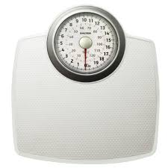
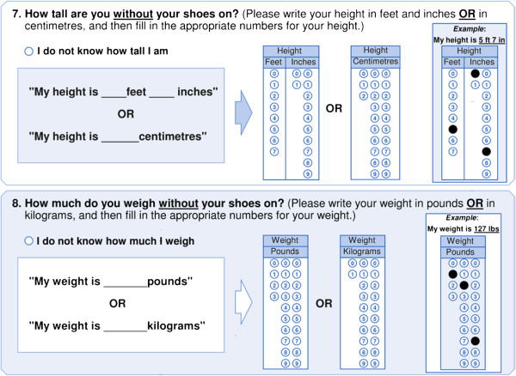
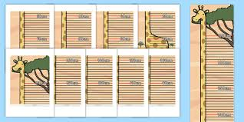
Measurement

Slide 4
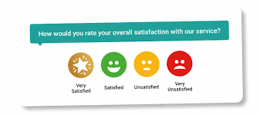
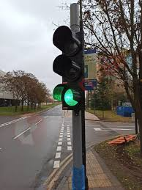
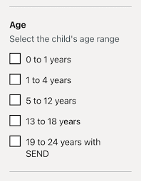

Measurement

Slide 5


Slide 6
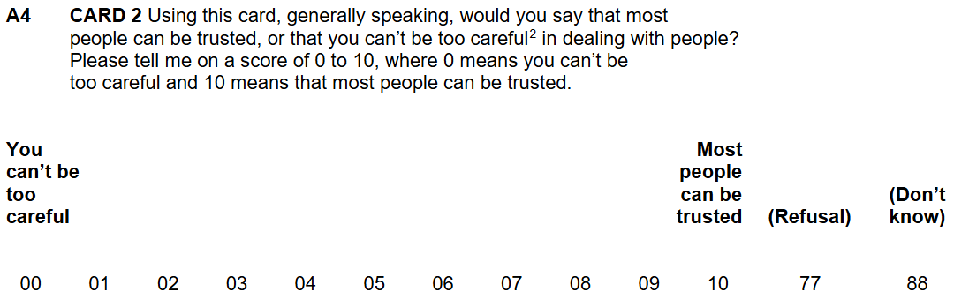
ESS11
² ‘Can’t be too careful’: need to be wary or always somewhat suspicious

Slide 7
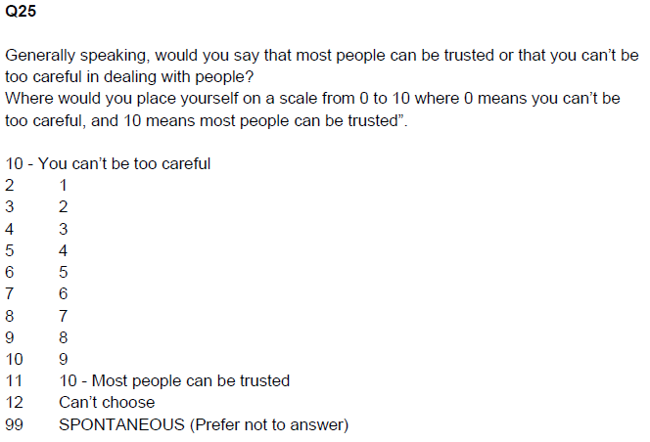
BSA 2024

Slide 8
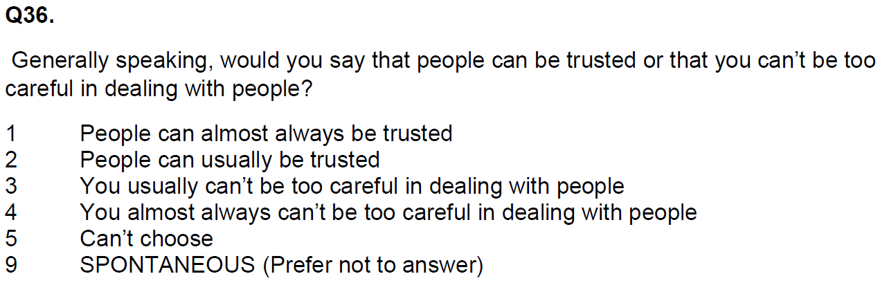
BSA 2023

Slide 9
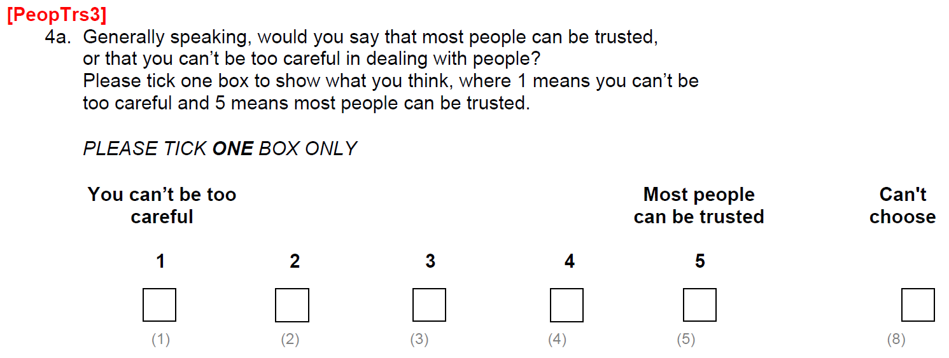
BSA 2010
(SELF-COMPLETION QUESTIONNAIRE)

Slide 10
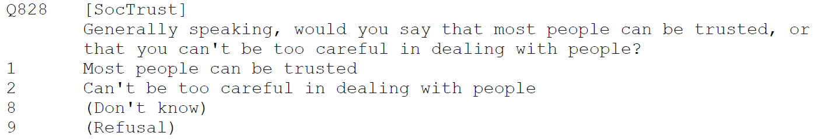
BSA 2010 (Q828)

Slide 11
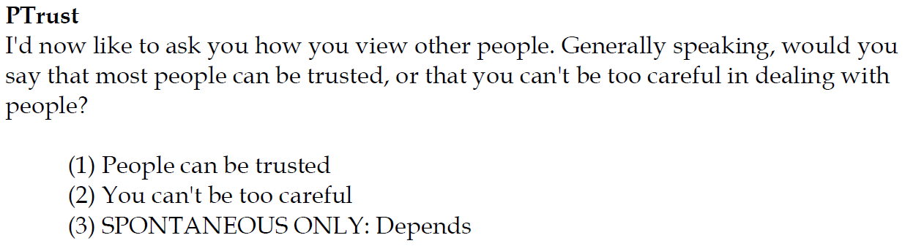
Citizenship Survey: 2010-11

Slide 12
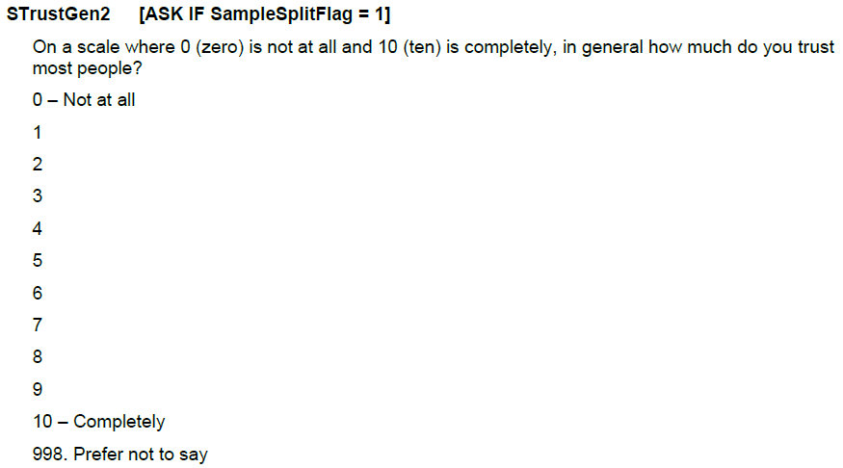
CLS 2023-24

Slide 13
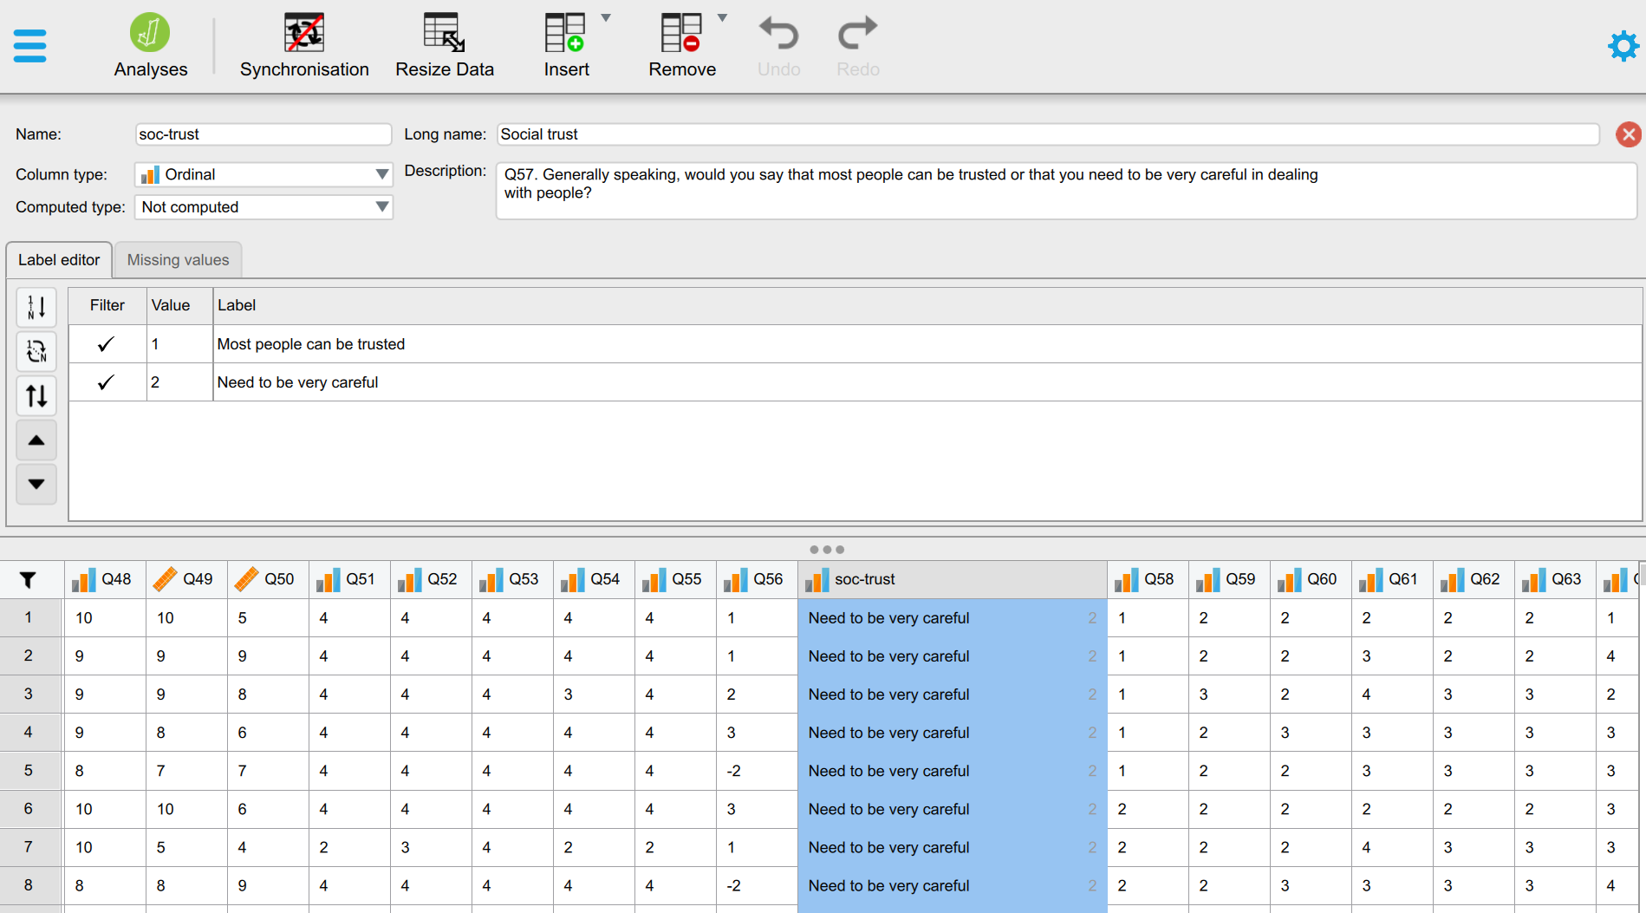
Variables in a dataset

Slide 14
Variables in a dataset

Slide 15
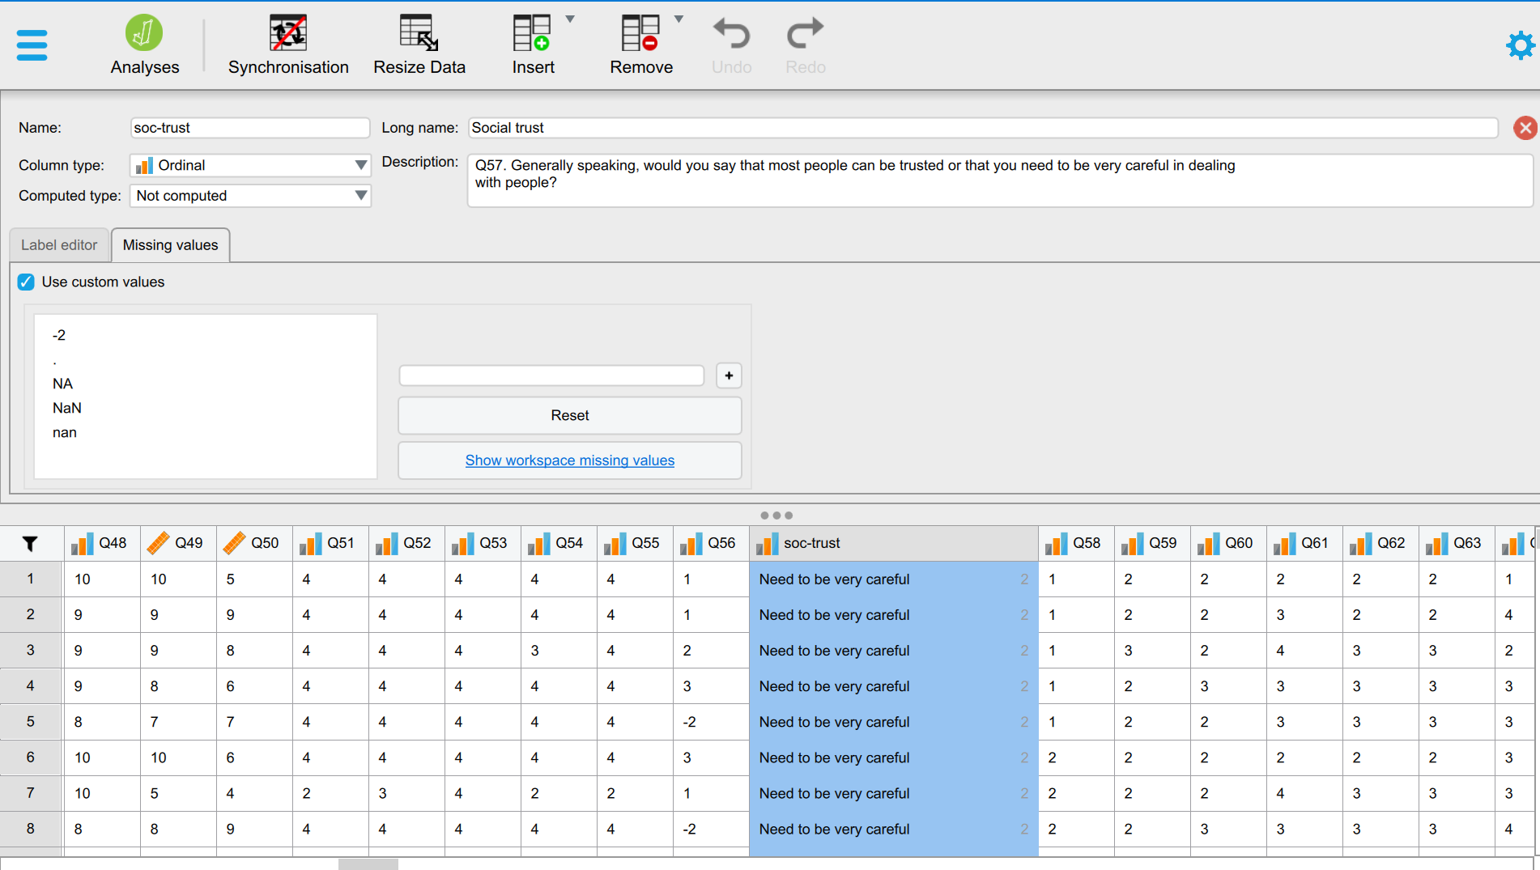
Variables in a dataset

Slide 16
Describing data
Univariate (e.g. an age distribution)
Bivariate (e.g. age distribution by gender)
Multivariate (e.g. age distribution by gender and ethnicity)
Notes:
So what exactly do we mean by ‘data’ here?
Variables

Slide 17
Describing data
Univariate (e.g. an age distribution)
Bivariate (e.g. age distribution by gender)
Multivariate (e.g. age distribution by gender and ethnicity)
Notes:
So what exactly do we mean by ‘data’ here?
Variables

Slide 18
Variable types and measurement levels
Data
Numerical
(Quantitative)
Categorical
(Qualitative)
Ratio
Interval
Ordinal, categories you can rank
Nominal, categories without order or direction
Dichotomous
(binary or ‘dummy’)
Polytomous
Height, weight, age, income
Temperature
e.g. educational attainment, satisfaction
e.g. gender
Marital status
Notes:
Numerical data more common in the natural, physical world;
In social science we have many categorical variables, as much of what we do is categorise people and their characteristics.

Slide 19
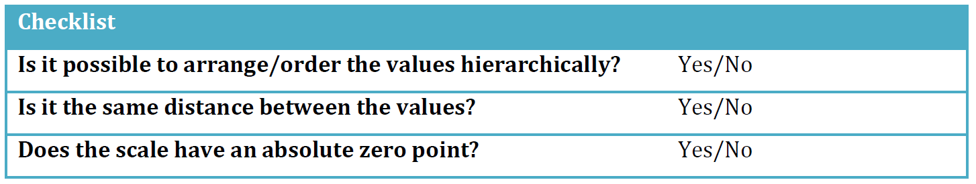
Variable types and measurement levels
Notes:
What does “arrange/order the values hierarchically” mean? If we take gender as an example, it is not reasonable to say that “Man” is less or more than “Woman”. As another example, we can take ethnicity: it is not reasonable to see “English” as less or more than “French”. For variables such as self-rated health, on the other hand, it is possible to say that “Excellent health” is better than “Good health”. Moreover, it is possible to say that a 2:1 grade is better than a 2:2.
What does “distance” mean? If we take income as an example, we know that 1000 dollars are twice as much as 500 dollars, and 2000 dollars are twice as much as 1000 dollars. The same logic applies to variables such as age: it is the same distance between 2 years and 4 years as between 6 years and 8 years. Thus, having the same distance between the values means that the differences between two values are the same regardless of which part of the scale you are looking at.
What does “absolute zero point” mean? Basically, it means that the scale cannot have negative values. It is possible for the temperature to be minus 10 degrees Celsius, but is not possible to have less than zero years of schooling or having less than zero days of unemployment.

Slide 20
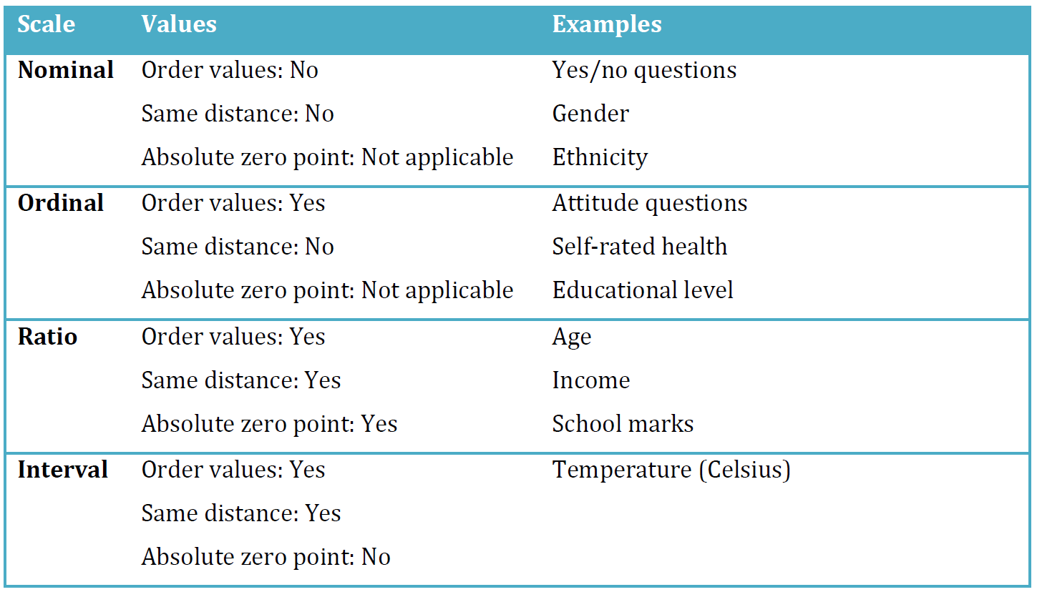
Variable types and measurement levels

Slide 21

Frequency
Counts, Percentages, Proportions, Ratios

Slide 22
Frequency distributions
The number, percentage, or proportion of those in a sample who fall into each category of a variable
Most useful for describing categorical variables measured at the nominal and (shorter) ordinal levels
Raw frequencies (counts)
Relative (standardised) frequencies (percentages, proportions, ratios)
Notes:
The social sciences are about explaining patterns among groups of people.
Statistical analysis begins with describing these patterns numerically. At the most basic level, this means counting the numbers of people who fit into different categories. These counts are called frequencies.
Example: the number of people in the dataset who prefer the UK to leave the EU;
Then, comparing this number to the total number of people in the dataset we can calculate the percentage or proportion of those who prefer the UK to leave the EU.
Simplest are raw frequencies
Relative frequencies obtained through standardization
Standardisation is important in many other contexts as it can provide simpler and comparable summary descriptions

Slide 23
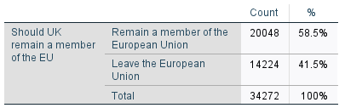
Simple frequency table

Slide 24



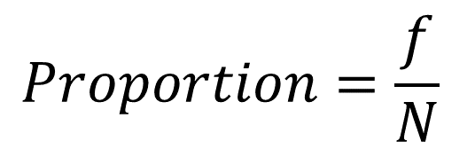
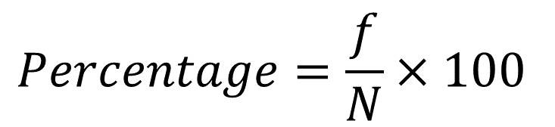
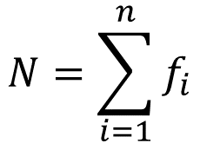
Simple frequency table

Slide 25
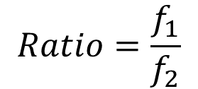
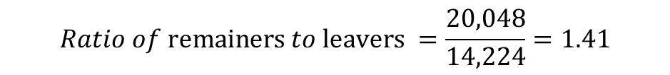
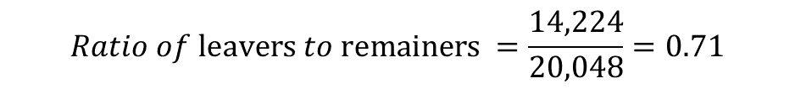
Simple frequency table
$$Ratio of \text{leavers} to \text{remainers} =\frac{14,224}{20,048}=0.71$$
$$Ratio of \text{remainers} to \text{leavers} =\frac{20,048}{14,224}=1.41$$
Notes:
Another statistic that is not usually produced in frequency tables but can be very useful for conveying quantities of interest; direct comparisons of different categories;
For every person preferring ‘remain’ there are 0.7 people preferring ‘leave’;
It sounds awkward to talk about fractions of human beings; so it’s often clearer to multiply the values by ten or its multiples to confer more meaningful summaries;
For every 10 remainers there are 7 leavers in the data

Slide 26
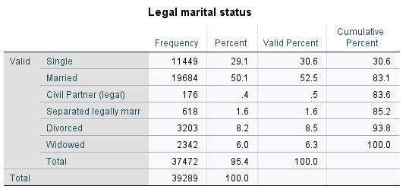
Question:
What is the ratio of singles to married respondents in the dataset?

Slide 27
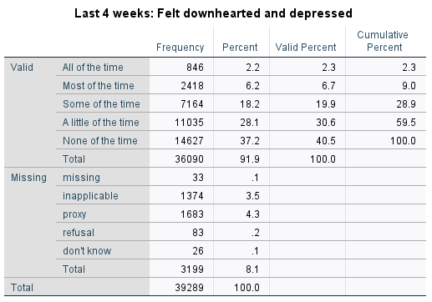
Summary frequency table

Slide 28
Summary frequency table

Slide 29
Central tendency
Mean, Median, Mode

Slide 30
Measures of ‘central tendency’
A single number that describes a typical value for a variable
Most useful for describing variables measured on numeric scales or at (longer) ordinal levels
Measures of central tendency can serve as standards for assessing whether the value of a single case is high or low (compared to the typical value)
Notes:
We often ‘measure’ central tendency in our daily lives

Slide 31
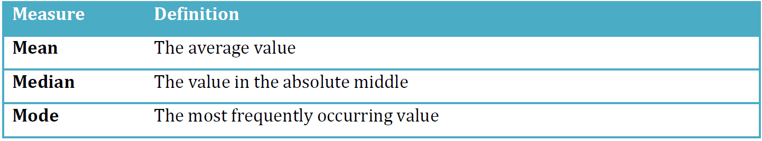
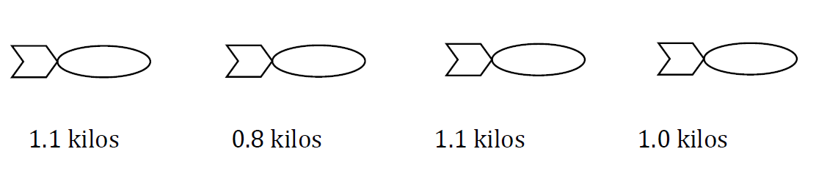
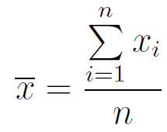
Measures of ‘central tendency’
Example 1: Mean
Notes:
Central tendency can be defined as measures of the location of the middle in a distribution.

Slide 32
Measures of ‘central tendency’
Example 1: Mean
1. Add values together
2. Divide sum by number of values
+ + + = 4
4/(1+1+1+1)=1 => Mean = 1 kilo
Notes:
Central tendency can be defined as measures of the location of the middle in a distribution.

Slide 33
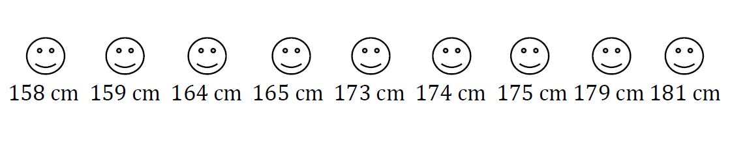
Measures of ‘central tendency’
Example 2: Median
Sort values from low to high and then identifying the value in the middle
Notes:
The median is the value in the absolute middle of the distribution. We sort all the values from low to high and then identifying the value in the middle of the list.
Media here is 173 cm.

Slide 34
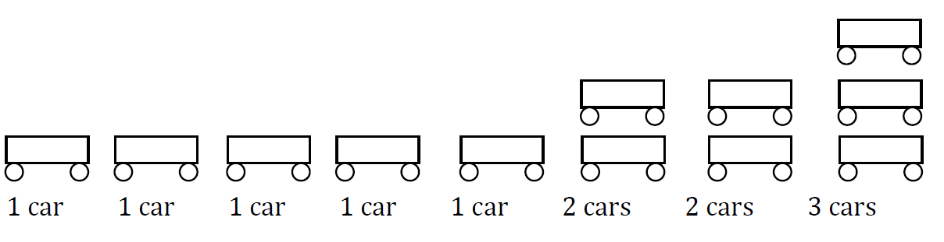
Measures of ‘central tendency’
Example 3: Mode
It’s the most frequently occurring value in a distribution.
Notes:
The mode - or “type” - is defined as the most frequently occurring value in a distribution: here 1.

Slide 35
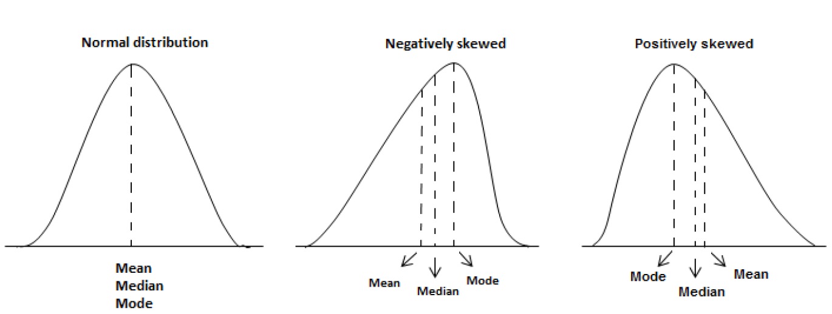
Measures of ‘central tendency’
Notes:
Always bell-shaped.
The peak always indicates the mean value.
Always symmetrical, i.e. the tails on each side of the mean are equally large. This means that 50 % of the values are on one side of the mean, and 50 % of the values are on the other side of the mean. The area under the curve is always 1 (100 % of the values).

Slide 36
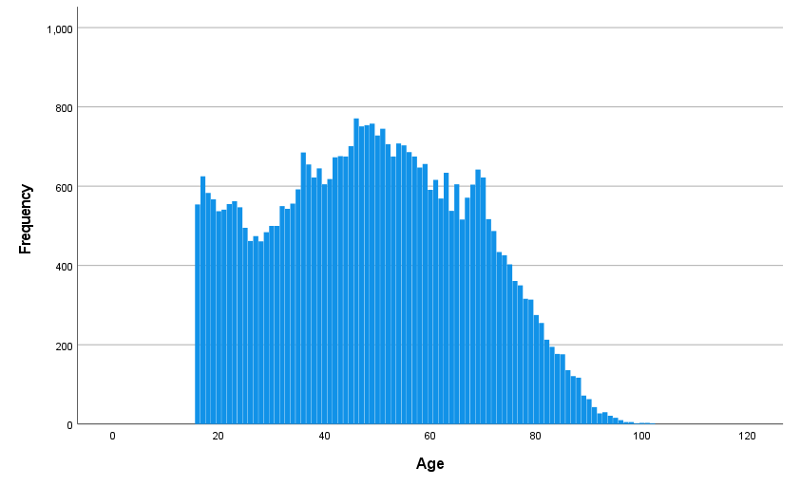
Example of age distribution

Slide 37

Example of age distribution

Slide 38
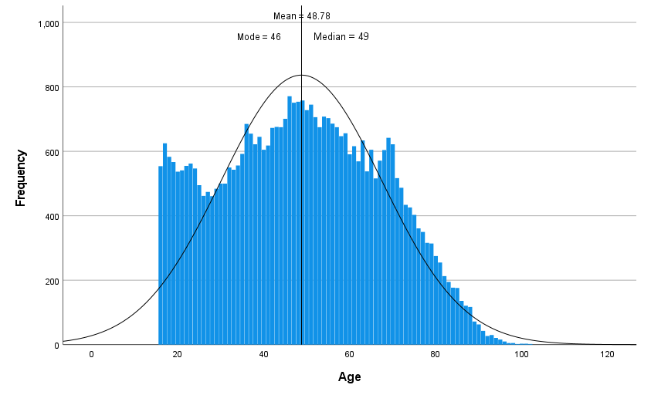
Example of age distribution

Slide 39
Dispersion
Range, Variance, Standard Deviation

Slide 40
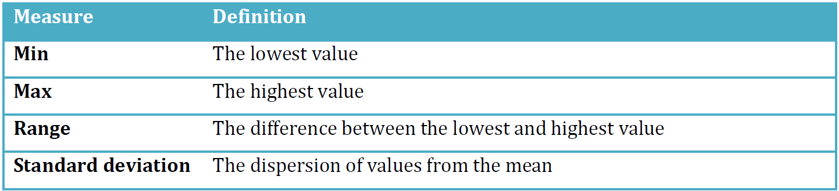
Measures of ‘dispersion’
Notes:
These measures are most suitable for continuous variables (i.e. ratio or interval) but sometimes min, max, and range are used for ordinal variables as well. However, they cannot be used for nominal variables (for the same reason as why we do not use mean or median to describe nominal variables).

Slide 41
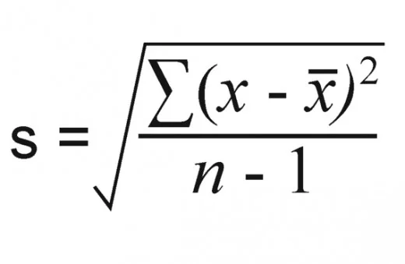
The Standard Deviation
The sample SD expresses how much variation exists from the mean for a given variable
1. Mean: the average of the numbers
2. Case deviations (Residuals): subtract the mean from each number
3. Variance: square each of the differences, add them up to get the sum of squares, and divide the sum of squares by the number of cases minus one
4. SD: take the square root of the variance
where xi is each value is the data set, x-bar is the mean, and n is the number of values in the data set
Notes:
The difference lies in the amount of spread of the values: because the shape of a normal distribution is not only defined by the mean value, but by the standard deviation!
But what is “standard deviation”? A simple definition is that it expresses how much variation exists from the mean for a given variable. If we have a low standard deviation, it suggests that the individuals in our data have values close to the mean, and if we have a high standard deviation, it indicates that the values are more spread out over a large range of values.

Slide 42

The Standard Deviation in an age distribution

Slide 43

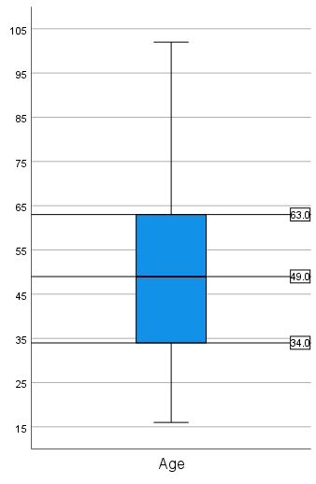
Percentiles and the IQR
Median = 50th percentile (P50)
P25
P75
Interquartile range (IQR) = P75 - P25
Notes:
While mean is ‘average’, median is the one in the ‘middle’; the 50th percentile; means 50% of the data is below the P50 value;
Divide each half into two again to get P25 and P75; the data is split into 4 quartiles;
The range between P25 and P75 measures the amount of data in middle 50%.
Boxplots specifically designed to capture this information.

Slide 44
Workshop
1-3pm

